Slide 1
Molecular Biology Biol 480
Lecture 25 March 27th, 2019

Slide 2
Announcements/Assignments
Out of town Friday/Monday—
No lab next Wednesday, April 3rd.
Exam Monday, April 1—proctored by Dr. Deufel
Topics today

Slide 3
Where were we? Translation
Details---translation
Amino acid sequence can direct a partially translated mRNA to the ER to complete its translation.
Please be sure to read the links with more detail regarding this mechanism. Proteins requiring some post-translational modifications, or which are packaged into vesicles, or which are embedded in the plasma membrane, or which will be secreted from the cell need to complete translation in the ER.

Slide 4
Some ER-bound proteins
Protein | Amino Acid Sequence*
Preproalbumin | Met-Lys-Trp-Val-Thr-Phe-Leu-Leu-Leu-Leu-Phe-Ile-Ser-Gly-Ser-Ala-Phe-Ser ↓ Arg . . .
Pre-IgG light chain | Met-Asp-Met-Arg-Ala-Pro-Ala-Gln-Ile-Phe-Gly-Phe-Leu-Leu-Leu-Leu-Phe-Pro-Gly- Thr-Arg-Cys ↓ Asp . . .
Prelysozyme | Met-Arg-Ser-Leu-Leu-Ile-Leu-Val-Leu-Cys-Phe-Leu-Pro-Leu-Ala-Ala-Leu-Gly ↓ Lys . . .
This ER signal sequence is usually cleaved off of the mature protein after it directs the newly synthesized protein to complete translation in ER.

Slide 5
Proteins can be directed to other compartments with peptide signal sequences
https://en.wikipedia.org/wiki/Target_peptide
For example---a different peptide sequence directs newly synthesized proteins into the nucleus
What types of proteins need to make their way into the nucleus. Think of examples.

Slide 6
Post-Translational Modifications
N-terminus amino acid is often removed or modified
Individual amino acids are often modified (see next slide)
Polypeptide chains may be trimmed
Signal sequences are removed
Polypeptides are often complexed with metals
http://en.wikipedia.org/wiki/Posttranslational_modification

Slide 7
Most common PMTs
Methylation

Slide 8
Specific amino acids can be modified in specific ways.

Slide 9
Again we see how a finite number of genes in a genome can really encode a much larger number of proteins.

Slide 10
Let’s not lose sight of how amino acid sequence affects protein folding and how protein folding affects protein function…
Protein structure DETERMINES what the protein does. Failure to fold correctly or to be properly modified, mean the protein does not work.

Slide 11
For example, enzymes which don’t fold properly will likely have modified active site shape and will not bind properly to their substrate(s).
If the enzyme is essential to the cell’s function, the cell will likely die. At the very least, the cell will be useless to the organism.

Slide 12
In some cases, misfolded proteins are more than useless—they can be dangerous.
Neurodegenerative diseases like Alzheimer and, mad cow and Creutzfeldt-Jakob disease (the human version of mad cow disease) are the result of misfolded proteins that actually damage normal tissue.

Slide 13
The proteins associated with mad cow disease and CJD-- known as prions---coax other molecules of the same protein to misfold.
There is no amino acid sequence difference between the normal protein and the misfolded version.

Slide 14
Review the translation animation---note how the nascent protein emerges from the ribosome and and sort of wiggles and interacts with itself.
Proteins begin folding as soon as some of the N-terminus emerges from the ribosome. They. “try out” interactions until the most favorable conformations are made.

Slide 15
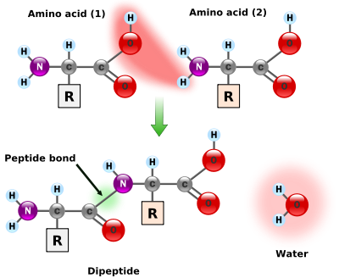
Let’s look at amino acid structure again. All amino acids have a common backbone structure.

Slide 16
See handout from Monday
Each of the 20 amino acids has a unique side chain/R-group.

Slide 17
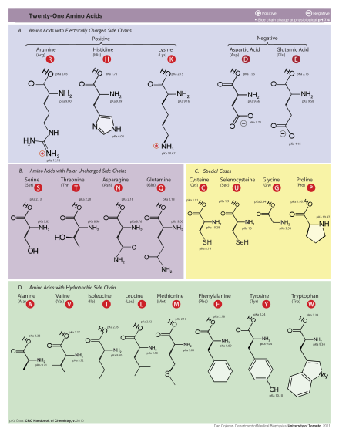

Slide 18
The chemical reactions/bonds made in proteins are the result of:
Interactions of atoms in every amino acid (backbone interactions)
Interactions of atoms in specific R groups.

Slide 19
Protein folding is the result of interactions, primarily noncovalent interactions, between amino acids that are not linked by peptide bonds. (not adjacent amino acids)
Protein folding is defined in 4 levels.

Slide 20
Protein structure
Primary structure is simply the amino acid sequence of a protein. (Thus technically not an aspect of folded structure)
Primary structure, determines everything about the final, folded structure of the protein. (And for some proteins, the location of the protein)

Slide 21
Secondary structure
Only 2 forms of secondary structure:
α helix
β sheet
Both form with certain primary structure using backbone interactions---
H-bonds involving atoms of the amino groups and carboxy groups. (R-groups are not involved)
Figure 15-18

Slide 22
α helix

Slide 23
β sheet/β pleated sheet

Slide 24
Tertiary structure
Most proteins’ complete structure is a mixture of alpha helices and beta sheets. The arrangement of secondary structure regions makes the tertiary structure of the protein.
Tertiary structure usually involves R-group interactions rather than amino or carboxy groups

Slide 25
Read about some of the ways in which amino acids interact
Ionic interactions
Hydrophobic interactions
Hydrophilic interactions
Most proteins have a combination of these types of interactions.

Slide 26
Proteins with a combination of helices and sheets are called globular. (most enzymes are globular proteins)
Proteins that are primarily helices or primarily sheets are called fibrous proteins. Fibrous proteins are usually long or extended and provide strength.

Slide 27
Some tertiary structure is formed by covalent interactions between sulfur groups (which amino acids have sulfur?). Di-sulfide bonds can join amino acids that are present in different regions of secondary structure.

Slide 29
Quaternary structure
Only applies to proteins made of 2 or more separate polypeptide subunits.
2 subunits=dimer
3 subunits=trimer
4 subunits = tetramer
(all considered oligomers)
most of the interactions that form tertiary structure, also facilitate quaternary structure.

Slide 30
Shape determines function…continued
We have discussed protein structure a bit.
We have even discussed some specific motifs that facilitate a specific function---DNA binding.
Some proteins have one primary function and their overall shape dictates that function.
Some proteins have to do several things simultaneously---how is that possible?

Slide 31
This (green) protein binds DNA (how? What types of protein motifs bind DNA?)—but likely does something once it is bound to DNA

Slide 32
Functional Domains
Domain: portion of a protein that folds into stable, unique conformations independent of the rest of the molecule
Domains give different functional capabilities
Proteins can contain one to several domains
Thought to have arisen as a result of “exon shuffling” (see upcoming slides)

Slide 33
LDL Receptor Exons
Figure 14.22
Notes:
Figure 15-22 A comparison of the 18 exons making up the gene encoding the LDL receptor protein. The exons are organized into five functional domains and one signal sequence.

Slide 34
Some common domains

Slide 35
How did unique proteins come to have common domains?
Exon Shuffling…
It’s thought that new proteins have been made over time by DNA recombination and movement of DNA in the genome. In a sense, just reusing a limited number of protein coding sequences in different ways….read more on your own.
http://en.wikipedia.org/wiki/Exon_shuffling#History

Slide 36
Remember….
It is thought that protein folding starts as soon as a few amino acids are linked together and emerge from the ribosome, but as the protein lengthens more favorable interactions replace those made early on.

Slide 37
In the end all proteins have a beginning (an amino (N)- terminus and an ending, carboxy (C)- terminus.
They are at maximum distance from each other in the protein primary sequence, but can be very near one another when you consider the protein’s tertiary structure.

Slide 39
Some proteins require other proteins to fold properly. Because of this tendency for proteins to fold right away, the end terminus may fold up and be unable to form proper structure with a more C-terminal region.
Proteins called chaperones function to sort of prevent some folding of a newly made protein until more of the amino acids are available.

Slide 40
Some chaperones also serve to protect proteins from unfolding if a cell is exposed to denaturing conditions.
For example, special chaperone proteins called heat-shock proteins, serve to protect a cell from short exposures to increased heat.

Slide 41
Without these heat shock proteins some proteins would denature and likely stick together with even small increases in heat.
http://en.wikipedia.org/wiki/Heat_shock_protein

